Slide 1
Create a chatbot using python
Submitted by
V.Shuruthilakshmi
V.Nishanthini
M.Nandhini
Sangavi.S

Slide 2
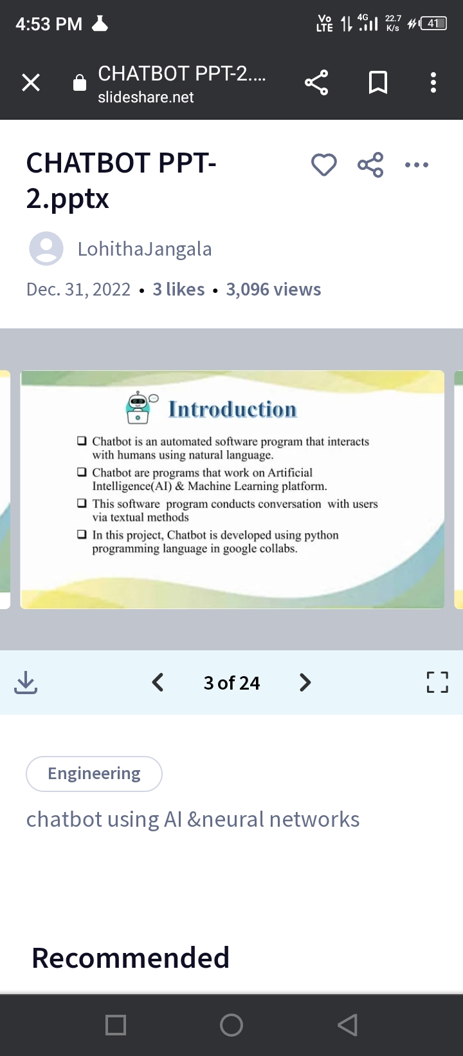

Slide 3
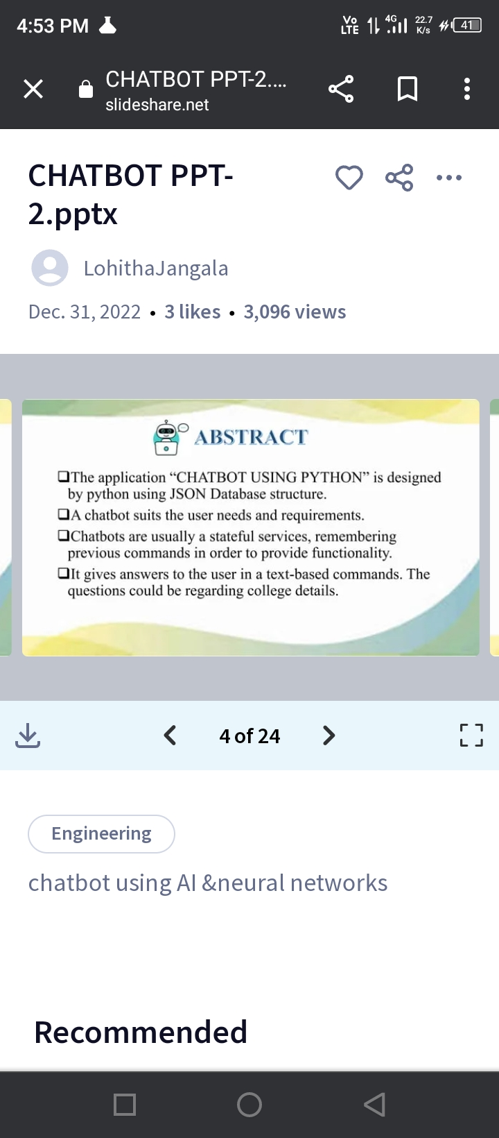

Slide 4
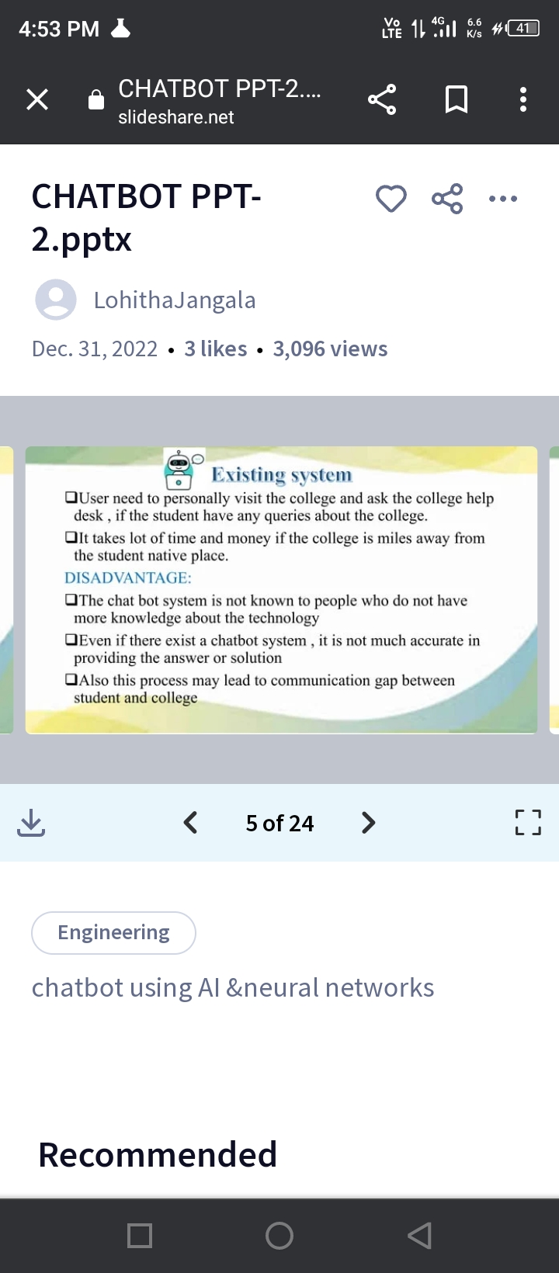

Slide 5
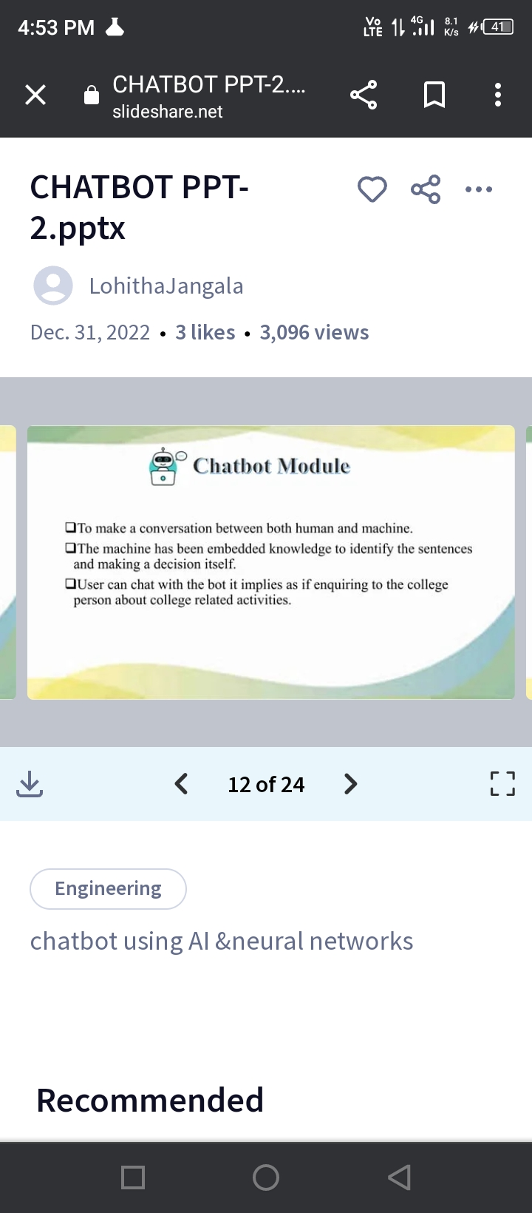

Slide 6
